Slide 1
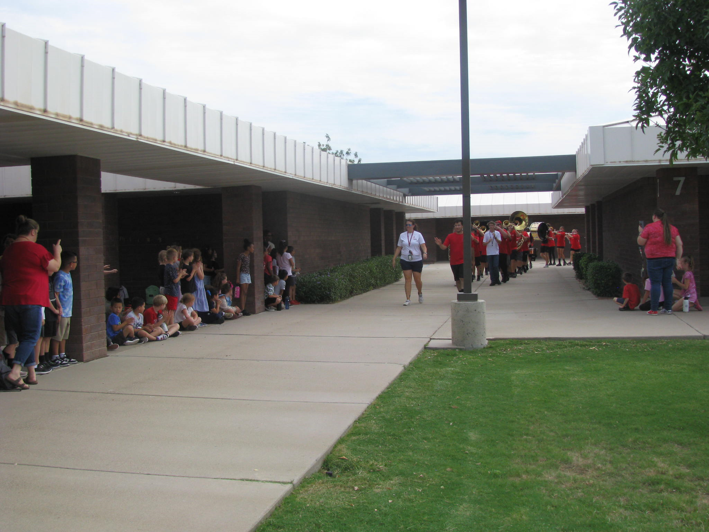
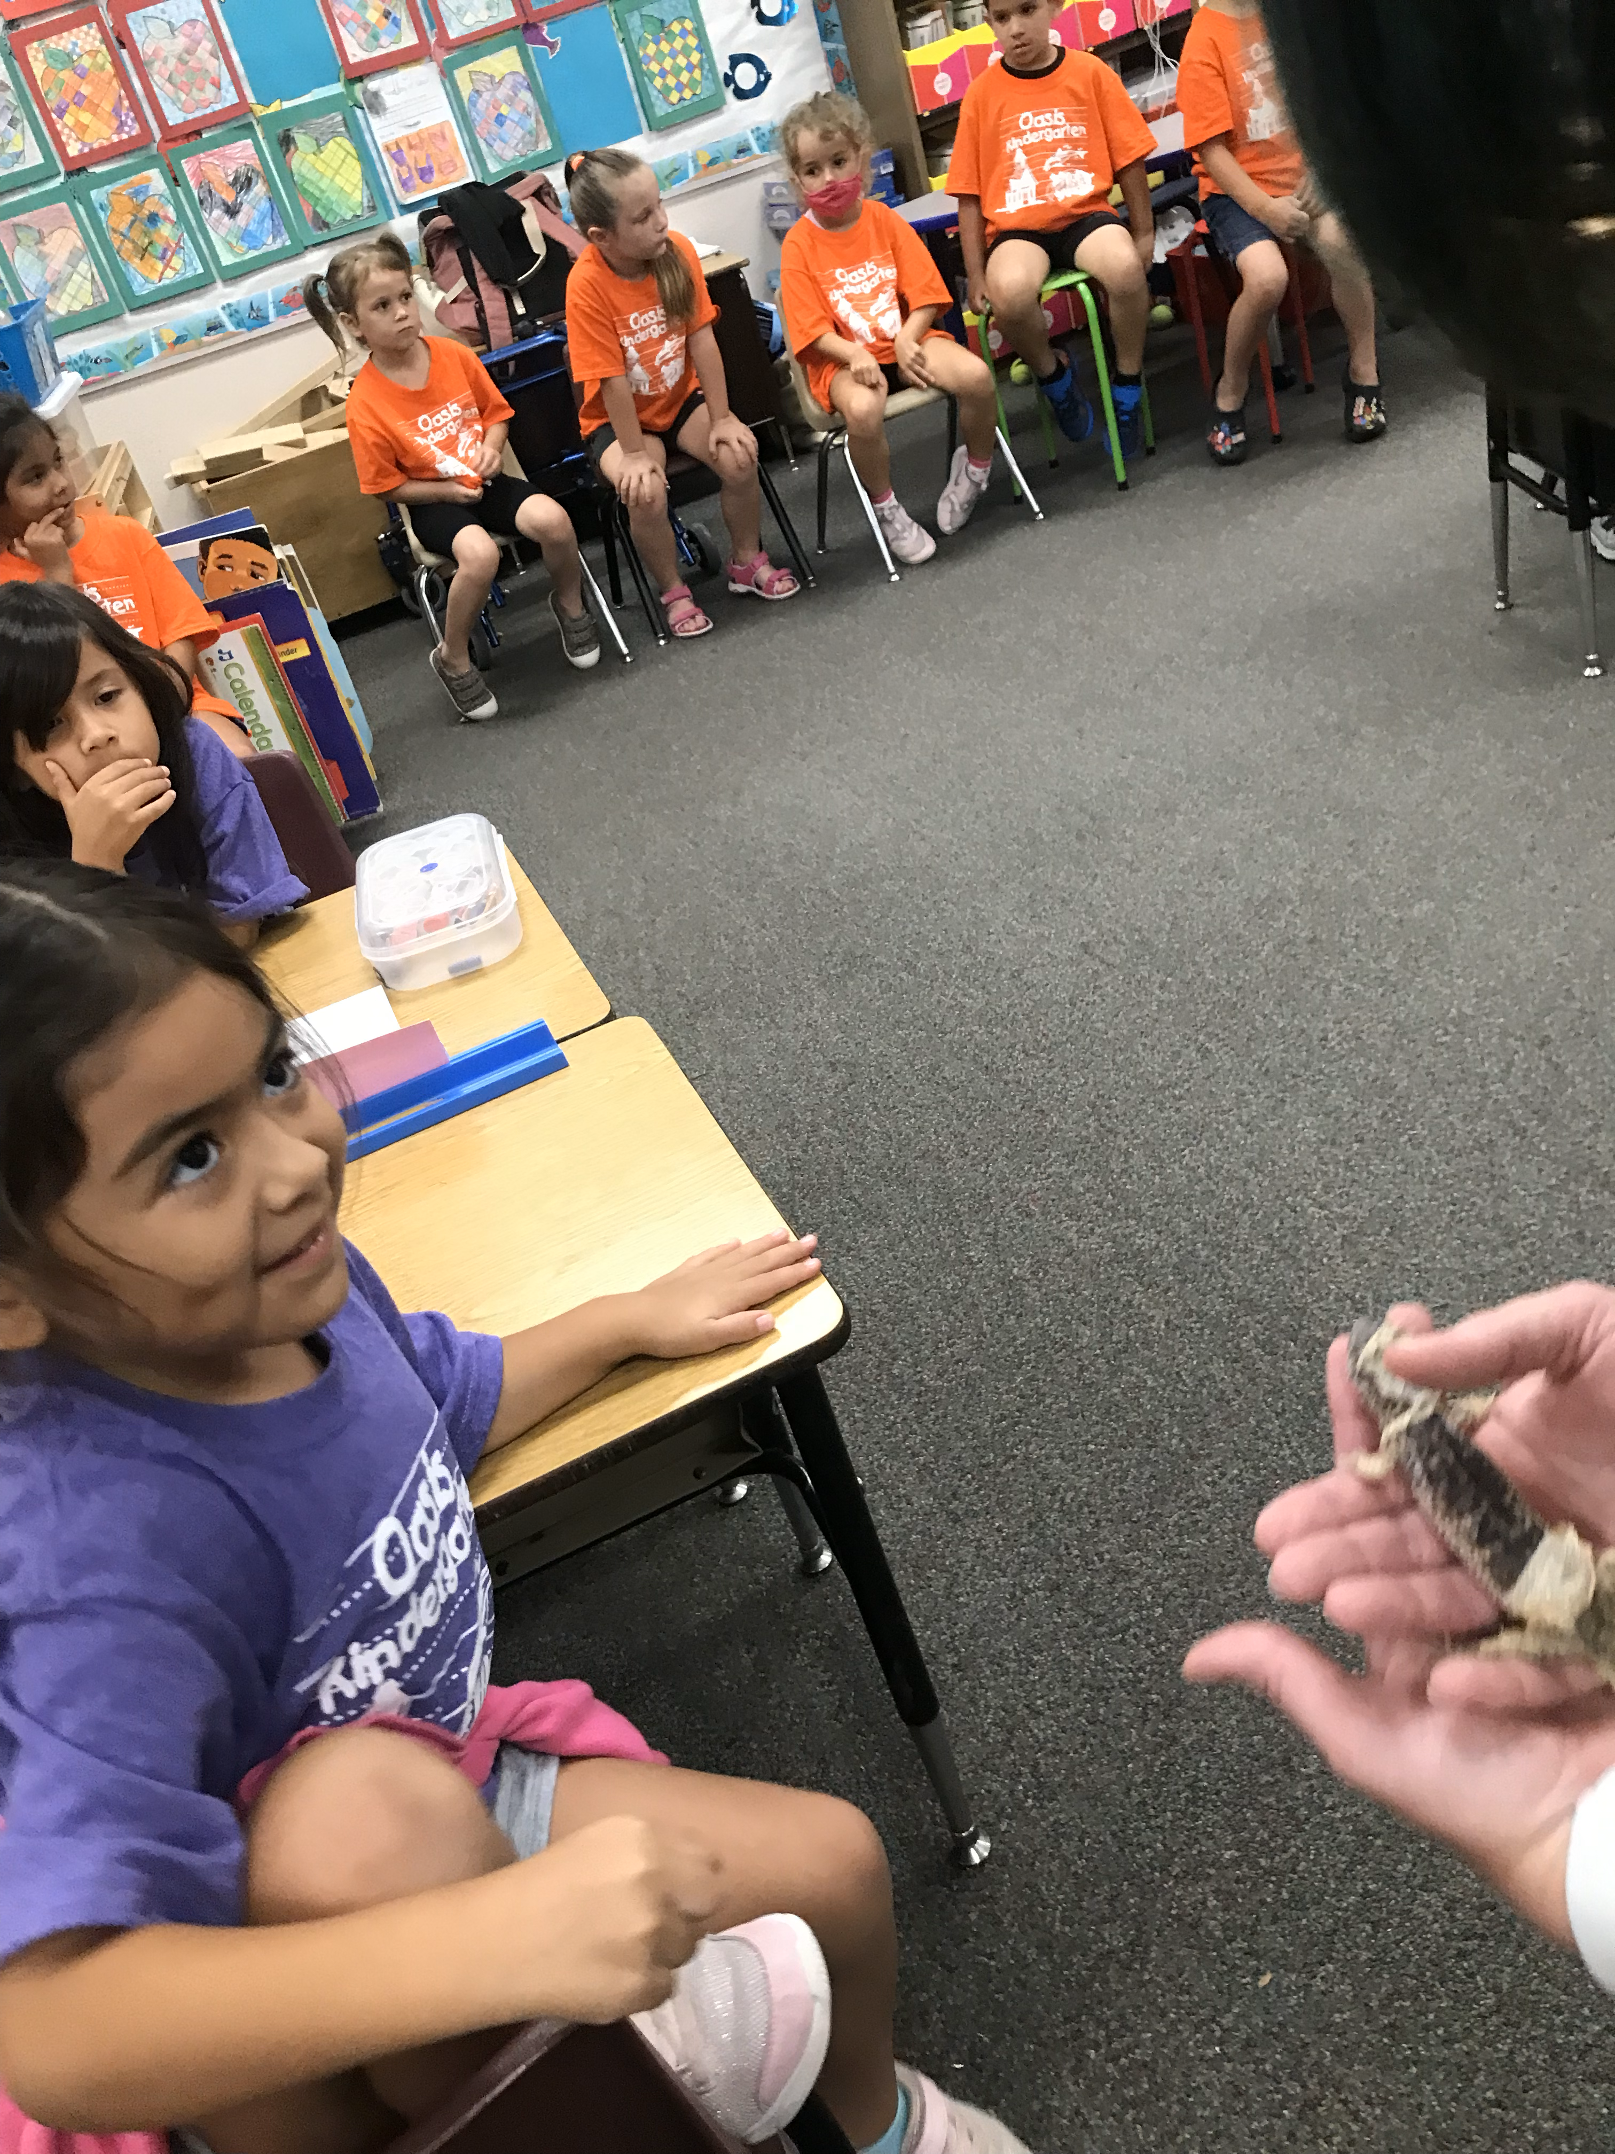
Oasis Elementary School
Annual Parent meeting
Tuesday, September 12, 2023

Slide 2
Agenda
Introductions
Title I Explanations and Qualifications
Title I programs and Services
Parent Involvement
Compact-Statement of Commitment
Questions

Slide 3
Introductions
Michelle Lewis, Principal
Emily Bryan, Assistant Principal
Jessica Hicks, Title I Instructional Assistant

Slide 4
Vision and Mission
Oasis Elementary
Vision
A Place to Belong, A Place to Succeed
Mission
Oasis exists to deliver high quality education that empowers all individuals to become the best version of themselves.
Peoria Unified School District
Vision
Every Student, Every Day, Prepared to Shape Tomorrow
Mission
“Empowering students to fulfill their potential”

Slide 5
Why are we here?
Title I is a federally funded program that requires each Title I School to hold an Annual Meeting with parents for the purpose of….
Informing you of your school’s participation in Title I
Explain the requirements of Title I
Explain your rights as parents to be involved

Slide 6
What does it mean to be a Title I school?
To qualify for the schoolwide Title I program each school must have a minimum of 40% of their students receiving free or reduced-price meals.
Title1 federal funds must be used to provide supplementary program services to all students
Each Title I school must complete the following annually:
Comprehensive Needs Assessment
Integrated Action Plan
Parents right to know

Slide 7
Our School Goals
Protect Instructional Time
Increase student, staff and family engagement
Use data to improve instruction

Slide 8
How are Title I fund being used at Oasis?
Helping students who are experiencing academic difficulties, so the students meet the state’s challenging content standards.
The hiring of an Instructional Assistant who supports reading and math programs by either pushing-in or pulling students out for small group help as needed.
After School Tutoring

Slide 9
How funds are being spent…cont.
Purchase extra programs, materials, and technology
Classroom capital items to support small group instruction
Supplies to support a Multi-tiered system of support including our PRIDE program
Instructional materials to support skill building for students in grades K-4
Support for staff development and collaboration time to ensure alignment of curriculum and supports for students in grades K-8.

Slide 10
How funds are being spent…cont.
Promote family education and engagement through school wide events such as:
Meet the Teacher Night
Bike and Walk to School Day
Student of the Month Assemblies
Read Across America Day
Book Fair
Spring Carnival

Slide 11
Oasis Values Parental Involvement
Education succeeds best when there is a strong partnership and communication between home and school.
Oasis Elementary shall implement programs, activities and procedures for the education and involvement of parents.

Slide 12
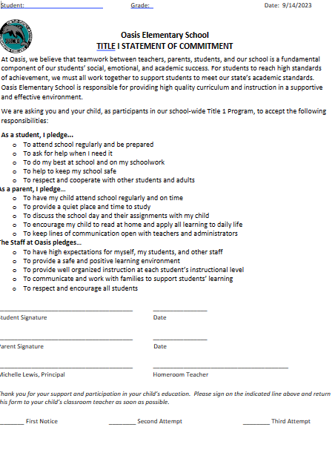
What is the School/Home Learning Compact?
The school/home learning compact serves as a commitment from all stakeholders that the education of the students is a priority.
The compact outlines responsibilities for the parent, student, teacher and principal/district.

Slide 13
Upcoming Family Events
Monthly PTSO Meetings
Monthly Student of the Month Assemblies
Bike and Walk to School Day
Fall and Spring Book Fairs
Athletic Events
Parent conferences held twice annually
Drama Performances in Fall and Spring
Veteran’s Day Luncheon
Fine Arts Performances
Kids Heart Challenge
Color Run
Field Trips throughout the year
Read Across America Day
Student Field Days
Mother and Son Neon Party
Father Daughter Sock Hop
Bike and Roll to School Day
Awards Nights
8th grade Promotion
Kinder Promotion

Slide 14
School Achievement
State assigned school grades for 2022-2023 school year are expected to be out sometime this month.

Slide 15
Questions

Slide 16
Thank you for coming and participating in our Annual Parent Meeting.
Oasis Elementary School
623-412-4800
Michelle Lewis, Principal
milewis@pusd11.net
Emily Bryan, Assistant Principal
ebryan@pusd11.net

